Slide 1
Object Oriented Concepts

Slide 2

Status of Software Engineering
A son mentioned to his father that for his birthday, he would like something that accelerates from 0 to 100 in four seconds.
Son was expecting something like this........

Slide 3

Status of Software Engineering
But father presented him with something very different...

Slide 4




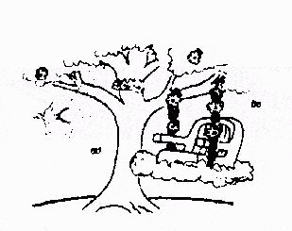
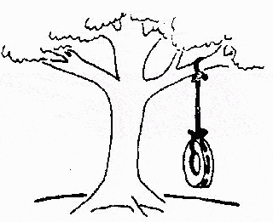
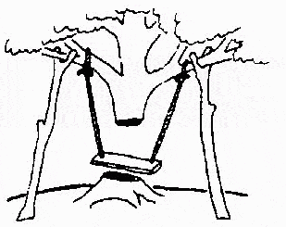
Status of Software Engineering
The requirements specification was defined like this
The developers understood it in that way
This is how the problem was solved before.
This is how the problem is solved now
This is how the program is described by marketing department
That is the program after debugging
This, in fact, is what the customer wanted …

Slide 5
Object oriented concepts
The size and complexity of software is increasing day by day. Conventional approaches of software design and implementation may not be effectively applicable.
We want to simplify the development process and to produce high quality maintainable software.
As we all know, development may take few years and same may have to be maintained for many years.
A maintainable software may reduce the maintenance cost and high quality may enhance the sustainability of the software.

Slide 6
Object oriented concepts
It is becoming popular to design, develop and maintain large size, complex and critical software systems using object oriented paradigm.
Due to its popularity and acceptability in customers, companies are also releasing the object oriented versions of their existing software products.
Many of the customers expect object oriented software solutions and request the same for their forthcoming projects.

Slide 7

What is Software Engineering?
There are two words ‘software’ and ‘engineering’.
Engineering forces us to focus on systematic, scientific and well defined processes to produce a good quality product.
The application of a systematic, disciplined, quantifiable approach to the development, operation and maintenance of software, and the study of these approaches, that is, the application of engineering to software.

Slide 8
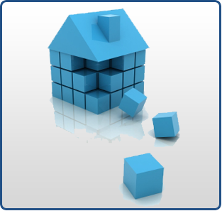
What is Software Engineering?
It is a profession dedicated to designing, implementing, and modifying software so that it is of higher quality, more affordable, maintainable, and faster to build.

Slide 9
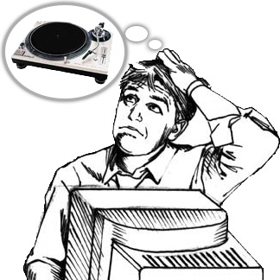
What is Software Engineering?
Program vs. Software
Program is set of instructions written for a specific purpose.
Software is the combination of program(s), documentation (documents produced during development) and operating procedure manuals (delivered with programs to customer at the time of release).

Slide 10
What is Software Engineering?
Program vs. Software
Software
Program(s)
Documentation
Operating procedure manuals

Slide 11

What is Software Engineering?
Program vs. Software
Software Requirements and Specification document
Software Design Document
Test plan document
Test suite document
Source code

Slide 12
What is Software Engineering?
Program vs. Software
Installation manual
System administration manual
Beginner’s guide tutorial
System overview
Reference guide

Slide 13
Software Characteristics
Software does not wear out.
Burn-in
phase
Wear out
phase
Useful life
phase
Failure Intensity
Time

Slide 14
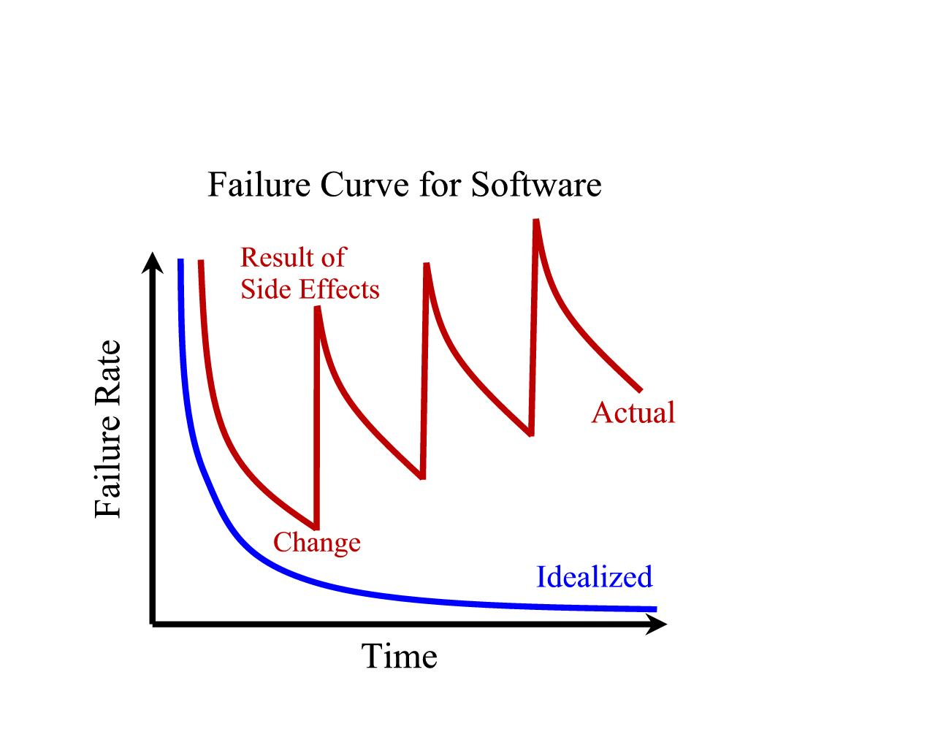
Software Characteristics
Flexibility of Software
Reusability of Software

Slide 15

What is Object Orientation?
Why is object oriented software development taking centre stage in software industry?
Why object oriented version of existing software products are coming in the market?

Slide 16

What is Object Orientation?
We feel that real strength of object oriented approach is its modeling ability to represent real world situations.
A model helps us to visualize and understand a real situation along with its behavior.
Architects use models to demonstrate their conceptual constructs which may also increase the confidence of their clients in terms of design, aesthetics and feel of the proposed project.

Slide 17
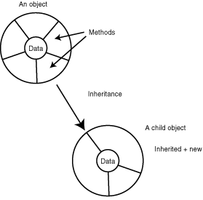
What is Object Orientation?

Slide 18
Classes & Objects
All book types may be combined to form a group called class.
All objects are instances of a class.
The class describes the structure of the instance which include behaviour and information.
Class
Book
Software
Engineering
Software
Testing
Software
Quality
Object1
Object2
Object3

Slide 19

Classes & Objects
Suppose there are 10 books in a library of same subject, language, publisher and author; but these books are distinguishable due to their own title and accession number.
All objects have unique identification like accession number in case of a book in the library. In a library, book, student, faculty, employee are the example of objects.

Slide 20
Classes & Objects
A set of objects with similar behaviour & information may constitute a class.
Hence, an object has a state (information) and it offers number of operations (behaviour) depending upon its class.

Slide 21
Classes & Objects
A class represents a template for several objects and describes how these objects are structured internally. Objects of the same class have the same definition both for their operations and for their information structures.
An instance is an object created from a class. The class describes the (behaviour & information) structure of the instance, which the current state of the instance is defined by the operations performed on the instance.
An attribute (or information / state) is a data value held by the object of a class.
Operations (or behaviour) are the functions which may be applied on a class.

Slide 22
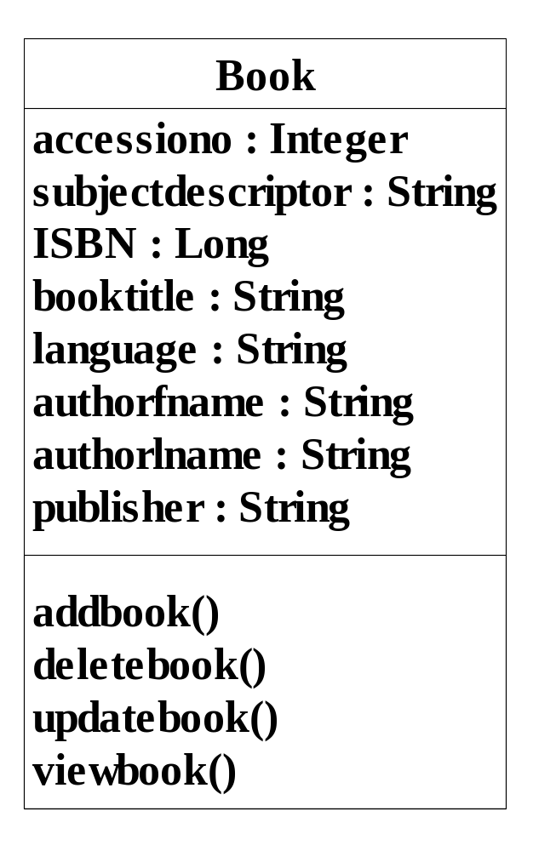
Classes & Objects
Class name
Attributes
Book Class
Operations

Slide 23
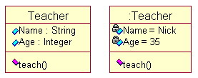
Classes & Objects

Slide 24

Messages
Objects communicate through passing messages.
A message is a request for performing an operation by some object in the system.
A message may consist of the identification of the target object, name of the requested operation and other relevant information for processing the request.
An object which originates a message is called the sender and the object which receives a message is called the receiver.

Slide 25
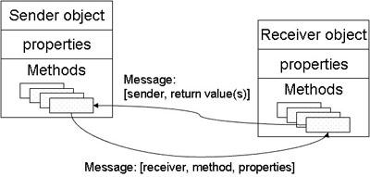
Message Exchange in Classes

Slide 26
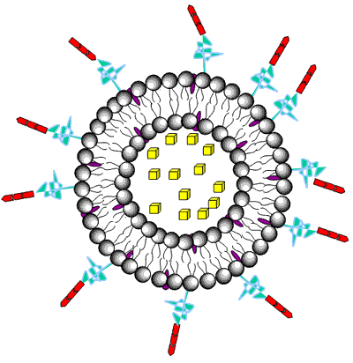
Encapsulation
Encapsulation is also known as information hiding concept.
The data and operations are combined into a single unit.
The only way to access data is through operations which are designed to operate on the data.
The data is not available to external world.
This concept may make the data safe and secure from external interventions.

Slide 27
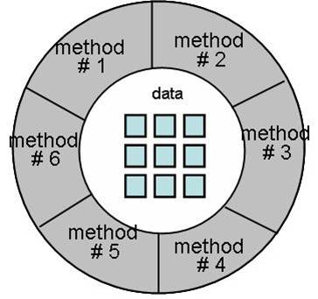
Encapsulation

Slide 28
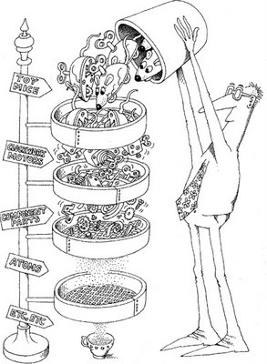
Inheritance
We may organize our knowledge in terms of hierarchy of categories.
All classes inherit information from the upper classes.
Each derived class inherits the attributes of its base class and this process is known as inheritance. In general, low level classes (known as subclasses or derived classes) inherit state and behaviour from their high level class (known as a super class or base class).

Slide 29
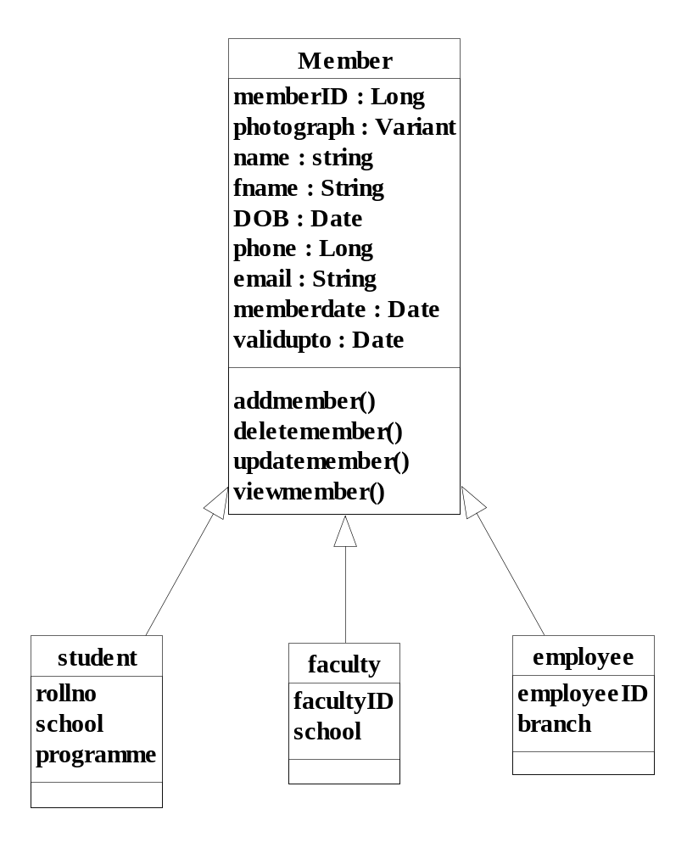

Slide 30
Inheritance
class Member
{
private:
long int memberID;
char photograph [300];
char name[50];
char fname [50];
Date DOB;
long int phone;
char email [60];
Date memberdate;
Date validupto;
public:
addmember();
deletemember();
updatemember();
viewmember();
};

Slide 31
Inheritance
class employee : public Member //publicly derived class
{
long int employeeID;
char branch[60];
};
class faculty : public Member //public inheritance
{
long int facultyID;
char school[100];
};
class student : public Member //public inheritance
{
long int rollno;
char school[100];
char programme[100];
};

Slide 32
Method
A ‘method’ is the sequence of steps (or set of operations) to be performed to fulfill the assigned task.
For example, four methods ‘addmember’, ‘deletemember’, ‘updatemember’, and ‘viewmember’ are implemented in Member class.
There may be many methods available for any task. It is the responsibility of receiver of the message to choose an appropriate method to complete task effectively & efficiently.

Slide 33
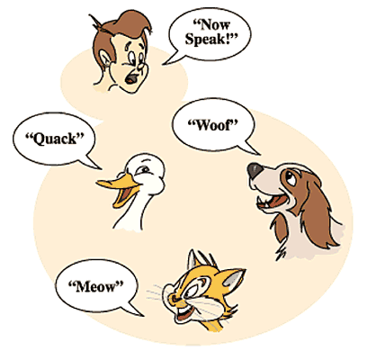
Polymorphism

Slide 34
Polymorphism
The dictionary meaning of polymorphism is “many forms”.
In the real world, the same operations may have different meanings in different situations.
Same message is sent to different objects irrespective of their class, but the responses of objects may be different.

Slide 35
Polymorphism
Polymorphism is considered to be an important concept of any object oriented programming languages.
    As we all know, arithmetic operators such as +, =, - are used to operate on primary data types such as int, float etc.
    We may overload these operators so that they may operate in the same way on objects (user defined data types) as they operate on primary data types.
    Thus, the same operators will have multiple forms.

Slide 36
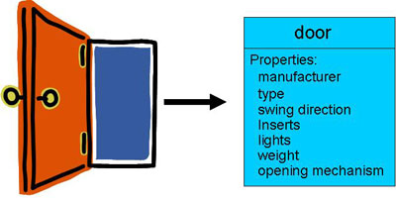
Data Abstraction
Data abstraction is to collect essential elements composing to a compound data.

Slide 37
Object Composition
The use of objects as data members in another class is referred to as object composition.
The object is a collection of set of objects represented through has-a relationship.
In object oriented systems, has-a relationship depicts that an object is declared as an attribute in another class.

Slide 38
Object Composition
Class A
{
………
};
Class B
{
A Oa;
};
A
B
………
Oa: A

Slide 39

Object Oriented Methodologies
Object oriented analysis by Coad and Yourdon
Object oriented design by Booch
Object modeling technique by Rumbaugh et al.
Object oriented software engineering by Jacobson

Slide 40
Object Oriented Methodologies
Coad and Yourdon Methodology
"Object-oriented analysis and design (OOAD) is a popular technical approach to analyzing, designing an application, system, or business by applying the object-oriented paradigm and visual modeling throughout the development life cycles to foster better stakeholder communication and product quality”
OOAD in modern software engineering is best conducted in an iterative and incremental way.

Slide 41

Object Oriented Methodologies
Coad and Yourdon Methodology
Identification of classes and objects
Identification of structures
Definition of subjects
Definition of attributes
Definition of services (methods)

Slide 42
Object Oriented Methodologies
Coad and Yourdon Methodology
Identification of classes and objects involves investigating the application domain and the system’s environment.
    The behavior of each objects are found and this information is documented. Identification of structures involve identification of is-a and whole-part relationships.
The is-a relationship captures class inheritance (known as Gen-Spec structure) and whole-part relationship captures the information that how an object is part of another object.

Slide 43
Object Oriented Methodologies
Coad and Yourdon Methodology
Each structure is classified into a subject.
Attributes are the data members of the class.
    The attributes for each object are defined and kept at the appropriate level in the inheritance hierarchy.
Defining services involve identification of operations in a class. This also involves identification of interfaces amongst the objects through messages.

Slide 44
Object Oriented Methodologies
Booch Methodology
Grady Booch proposed object oriented methodology in his book Object-Oriented Design (OOD) in 1991.
The primary aim of OOD was to establish a base for implementation of object oriented systems.
The Booch methodology can be broadly divided into two processes: macro process and micro process.

Slide 45
Object Oriented Methodologies
Booch Methodology
Establishment of requirements
Construction of analysis model
Design of architecture
Maintenance of delivered functionality
Evolution in the form of refinements

Slide 46
Object Oriented Methodologies
Booch Methodology
In first phase the requirements are established using context diagrams and prototypes.
The outcomes of this phase are core requirements of the system.
Analysis process involves requirement capturing and understanding. It involves “what of the system”. This phase consists of construction of use cases, identification and prioritization of risks.

Slide 47
Object Oriented Methodologies
Booch Methodology
Design phase focuses on construction of architecture of the system and involves:
    Identification of horizontal layers
    Mapping classes to subsystems
    Release planning
    Attaching risks identified in analysis phase to releases
Evolutionary phase involves implementation of the system and each release adds to the functionality of the system.
Maintenance phase consists of post deployment activities.

Slide 48
Object Oriented Methodologies
Booch Methodology
It is the lower level process. The following recursive steps are followed in OOD micro process
  Identification of classes and objects
  Identification of semantics of classes and objects
  Identification of relationship amongst classes and objects
  Specification of interfaces and implementation of classes and objects

Slide 49

Object Oriented Methodologies
Rumbaugh Methodology
Rumbaugh developed a technique that focuses on analysis, design and implementation of the system. This technique is popularly known as Object Modeling Technique (OMT).
The OMT consists of four phases: analysis, system design, object design and implementation.

Slide 50
Object Oriented Methodologies
Rumbaugh Methodology
Analysis phase: Analysis phase is composed of three submodels given below:
  Object model: It captures the static aspect of the system.
  Dynamic model: It captures the behavioral aspects of the object models and describes state of the objects.
  Functional model: It represents the functional aspects of the system in terms of operations defined in the classes.

Slide 51
Object Oriented Methodologies
Rumbaugh Methodology
System design phase: In this phase high level design is developed taking the implementation environment including DBMS and communication protocols into account.
Object design phase: The goal of this phase is to define the objects in details. The algorithms and operations of the objects are defined in this phase. New objects may be identified to represent the intermediate functionality.
Implementation phase: Finally the objects are implemented following coding standards and guidelines.

Slide 52
Object Oriented Methodologies
Jacobson Methodology
All the methodologies described above still lack of a comprehensive architecture to develop a software project.
The Jacobson’s methodology known as “Object Oriented Software Engineering (OOSE)” consists of five models:
  The requirement model: The aim of the model is to gather software requirements.
  The analysis model: The goal of this model is to produce ideal, robust and modifiable structure of an object.

Slide 53
Object Oriented Methodologies
Jacobson Methodology
  The design model: It refines the objects keeping the implementation environment in mind.
  The implementation model: It implements the objects.
  The test model: The goal of the test model is to validate and verify the functionality of the system.

Slide 54
Object Oriented Modeling
Object oriented modeling is a way of constructing visual models based on real world objects.
Modeling helps in understanding the problems, developing proper documents and producing well designed programs.
Modeling produces well understood requirements, robust designs, high quality and maintainable systems.

Slide 55
Analysis Model
Analysis model operates as a link between the 'system description' and the 'design model'.
In the analysis model, information, functions and the behaviour of the system is defined and these are translated into the architecture, interface and component level design in the 'design modeling'

Slide 56
Analysis Model
Elements of the analysis model
1. Scenario based element This type of element represents the system user point of view.
Scenario based elements are use case diagram, user stories.
2. Class based elements The object of this type of element manipulated by the system.
It defines the object,attributes and relationship.
The behavioral elements are sequenced diagram, state diagram.

Slide 57
Analysis Model
The collaboration is occurring between the classes.
Class based elements are the class diagram, collaboration diagram.
3. Behavioral elementsBehavioral elements represent state of the system and how it is changed by the external events.
4. Flow oriented elementsAn information flows through a computer-based system it gets transformed.
It shows how the data objects are transformed while they flow between the various system functions.
The flow elements are data flow diagram, control flow diagram.

Slide 58
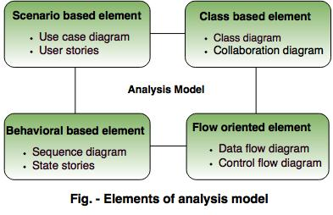
Analysis Model

Slide 59
The rules of thumb
The rules of thumb that must be followed while creating the analysis model.
The rules are as follows:The model focuses on the requirements in the business domain. The level of abstraction must be high i.e there is no need to give details.
Every element in the model helps in understanding the software requirement and focus on the information, function and behaviour of the system.
The consideration of infrastructure and nonfunctional model delayed in the design.

Slide 60
For example, the database is required for a system, but the classes, functions and behavior of the database are not initially required. If these are initially considered then there is a delay in the designing.
Throughout the system minimum coupling is required. The interconnections between the modules is known as 'coupling'.
The analysis model gives value to all the people related to model.
The model should be simple as possible. Because simple model always helps in easy understanding of the requirement.
Concepts of data modeling
Analysis modeling starts with the data modeling.
The software engineer defines all the data object that proceeds within the system and the relationship between data objects are identified.

Slide 61
Data objectsThe data object is the representation of composite information.
The composite information means an object has a number of different properties or attribute.
For example, Height is a single value so it is not a valid data object, but dimensions contain the height, the width and depth these are defined as an object.
Data Attributes
Each of the data object has a set of attributes.

Slide 62
Data object has the following characteristics:Name an instance of the data object.
Describe the instance.
Make reference to another instance in another table.
Relationship
Relationship shows the relationship between data objects and how they are related to each other.
Cardinality
Cardinality state the number of events of one object related to the number of events of another object.

Slide 63
Collaboration Diagram
A collaboration diagram, also known as a communication diagram, is an illustration of the relationships and interactions among software objects in the Unified Modeling Language (UML). These diagrams can be used to portray the dynamic behavior of a particular use case and define the role of each object.
Collaboration diagrams are created by first identifying the structural elements required to carry out the functionality of an interaction. A model is then built using the relationships between those elements. Several vendors offer software for creating and editing collaboration diagrams

Slide 64
Collaboration Diagram
Notations of a collaboration diagram
A collaboration diagram resembles a flowchart that portrays the roles, functionality and behavior of individual objects as well as the overall operation of the system in real time. The four major components of a collaboration diagram are:
Objects- Objects are shown as rectangles with naming labels inside. The naming label follows the convention of object name: class name. If an object has a property or state that specifically influences the collaboration, this should also be noted.
Actors- Actors are instances that invoke the interaction in the diagram. Each actor has a name and a role, with one actor initiating the entire use case.

Slide 65
Collaboration Diagram
Notations of a collaboration diagram
3. Links- Links connect objects with actors and are depicted using a solid line between two elements. Each link is an instance where messages can be sent.
4. messages- Messages between objects are shown as a labeled arrow placed near a link. These messages are communications between objects that convey information about the activity and can include the sequence number.
When to use a collaboration diagram
Collaboration diagrams should be used when the relationships among objects are crucial to display.

Slide 66
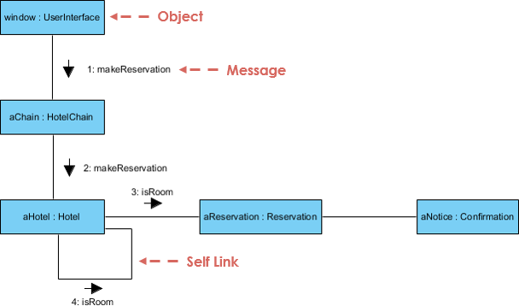
Collaboration Diagram

Slide 67
Object Oriented Modeling
UML represents the combination of the notations used by Booch, Rumbaugh and Jacobson.
The best concepts and processes were extracted from all the methodologies till date and combined into UML.
UML was adopted by Object Management Group (OMG) in November, 1997.
UML is defined as language for visual modeling that allows to specify, visualize, construct, understand and document the various artifacts of the system.

Slide 68

Some Terminologies
Customers, Developers and Users
Customers are persons who request the system, approve the system and pay for the system. Developers are the persons at the supplier side who are responsible for the development of the system. Users are the persons who will actually use the system.
For example in the library management system developed for a university, the customer is the university, developer is the one at the supplier side who develops the system and the users are the persons in the library staff who will actually work on the system.

Slide 69
Some Terminologies
Product and process
Product is what is delivered to the customer. It may include Software Requirement Specification (SRS) document, source code, test reports, user manuals and system guide.
Process is the way in which the software is produced. A process is like a tunnel through which the project goes in order to produce a product
product
process

Slide 70
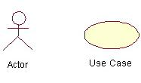
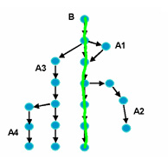
Some Terminologies
Actor, Use Case, Use Case Model and Use Case Scenario
An actor represents the role of a user that interacts with the system. Some of the examples of the actors used in “Library Management System” are administrator, data entry operator, student, library staff and faculty.
A use case describes who (any user) does what (interaction) with the system, for what goal, without considering the internal details of the system. The use case model depicts actors, use cases and the relationship between them.
A use case scenario is an instance of a use case or a complete path through the use case.

Slide 71
Some Terminologies
System and Subsystems
System is an organized and arranged structure as a whole that consists of interrelated and well defined procedures, processes and methods. All systems consist of inputs, outputs, feedback mechanisms and boundaries.
A system may consist of several subsystems. Subsystems are a way of reducing complexity of system.
For example, in a company, accounts, sales, marketing are different subsystems. In object oriented analysis, objects may be grouped together to form a subsystem.

Slide 72
Some Terminologies
Class, Responsibility and Collaboration
Class is template that consists of attributes and operations. Responsibilities are attributes and operations included in a class.
Collaborations are the other classes that a class calls in order to achieve the functionality.
The class, responsibility and collaboration are often combined together in object oriented analysis to depict the functionality of a class and relationship between classes.

Slide 73
Some Terminologies
Measures, Metrics and Measurement
A measure provides a quantitative indication of the extent, dimension, size, capacity, efficiency, productivity or reliability of some attributes of a product or process.
Measurement is the act of evaluating a measure.
A metric is a quantitative measure of the degree to which a system, component or process possesses a given attribute.

Slide 74
Some Terminologies
Quality and Reliability
Software reliability is one of the important factor of software quality.
Software reliability is defined as:
“the probability of failure free operation for the specified time in a specified environment”
Software Quality measures how well software is designed (quality of design), and how well the software conforms to that design (quality of conformance).
Software Reliability is one of the part of software quality.
To produce good quality product, a software tester must verify and validate throughout the software development process.

Slide 75
Some Terminologies
Quality Assurance and Quality Control
The purpose of quality assurance activities is to enforce standards and techniques to improve the development process and prevent bugs from ever occurring.
Quality assurance group monitors and guides throughput the software development life cycle. Examples are reviews, audits, etc.
Quality control attempts to build a software and test it thoroughly. It concentrates on specific products rather than processes as in the case of quality assurance. This is a defect detection and correction activity which is usually done after the completion of the software development,. Example is software testing at various levels.

Slide 76
Some Terminologies
Verification and Validation
Verification: (as defined by IEEE/ANSI)
It is a process of evaluating a system or component to determine whether the products of a given development phase satisfy the conditions imposed at the start of that phase.
Verification is the process of evaluating, reviewing, inspecting and doing desk checks of work products such as requirement specifications, design specification and code.
It can be applied to all those things that can be reviewed in the early phases to make sure that what comes out of that phase is what we expected to get.
It is a ‘human testing’ as it involves looking at the documents on paper.

Slide 77
Some Terminologies
Validation: (as defined by IEEE/ANSI)
It is a process of evaluating a system or component during or at the end of development process to determine whether it satisfies the specified requirements.
It involves executing the actual software.
It is a computer based testing process. It usually exposes symptoms of errors.
Definition: Testing = Verification + Validation

Slide 78
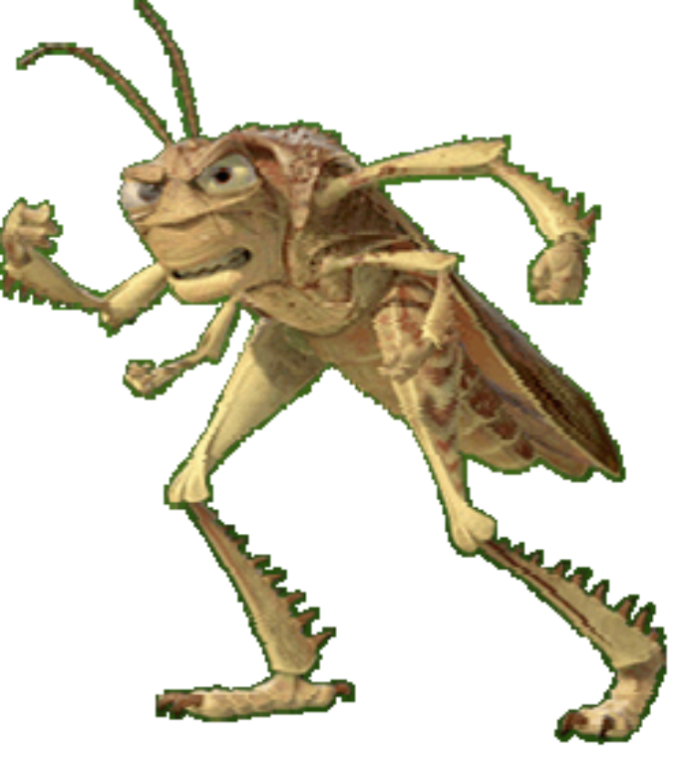
Some Terminologies
Error, Mistake, Bug, Fault and Failure
People make errors. A good synonym is mistake. This may be a syntax error or misunderstanding of specifications. Sometimes, there are logical errors.
When developers make mistakes while coding, we call these mistakes “bugs”.

Slide 79
Some Terminologies
A fault is the representation of an error, where representation is the mode of expression, such as narrative text, data flow diagrams, ER diagrams, source code etc. Defect is a good synonym for fault.
A failure occurs when a fault executes. A particular fault may cause different failures, depending on how it has been exercised.

Slide 80
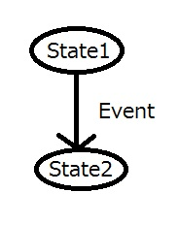
Some Terminologies
States and Events
A state is an abstract situation in the life cycle of an entity that occurs in response to occurrence of some event.
An event is an input (a message or method call). Due to occurrence of some event, the system transits from one state to other.

Slide 81
Some Terminologies
S. No | Traditional approach | Object oriented approach
1 | The system is viewed as collection of processes. | The system is viewed as collection of objects.
2 | Data flow diagrams, ER diagrams, data dictionary and structured charts are used to describe the system. | UML models including use case diagram, class diagram, sequence diagrams, component diagrams etc are used to describe the system.
3 | Reusable source code may not be produced. | The aim is to produce reusable source code.
4 | Data flow diagrams depicts the processes and attributes | Classes are used to describe attributes and functions that operate on these attributes.
5 | It follows top-down approach for modeling the system. | It follows bottom-up approach for modeling the system.
6 | Non iterative | Highly iterative

Slide 82

Summary
Object oriented software engineering is an upcoming area of research, practice and industrial applications.
All companies are making these processes compliant to object oriented paradigm.
Developers are focusing these learning processes on object oriented concepts and programming language like C++, Java etc.
Customers are also changing their mind sets towards object oriented software products.

Slide 83
